Slide 1

Research Data Management
25th April 2018
Federica Fina, Data Scientist, University of St Andrews Library
0000-0003-2594-350X

Slide 2
About the RDM team
Based at the Library
Formed in May 2015
1 FTE until October 2017
Currently 2 FTEs (until December 2018)
Support and advice on:
Data management best practice
Data management plans
Publishing data
Compliance with funders’ requirements
Training

Slide 3
Contents
Why research data management?
St Andrews RDM policy
The Research Data Lifecycle
Plan
Create and process
File naming conventions
Directory structure
Version control
Document methods, procedures
Metadata
Store and Preserve

Slide 4
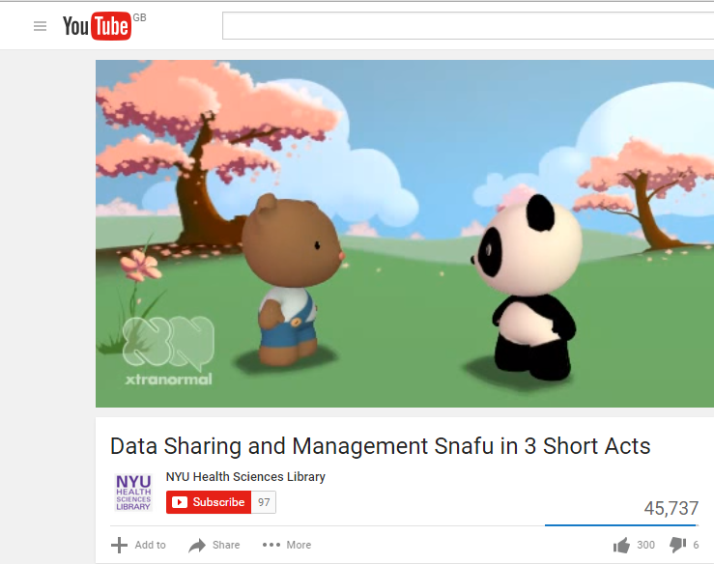
Why research data management?
https://www.youtube.com/watch?v=N2zK3sAtr-4&index=1&list=PL2XF5RiVI7GPXEhdylRmJjjSXXjsOQpT7

Slide 5
Why research data management?
Time is saved on the long term
Efficiency is increased
Performance is increased
The risk of loss and misplacement of data is reduced
Research integrity
The value of the data is maximised
Compliance with funders requirements can be made easier

Slide 6
St Andrews RDM policy
The purpose of data management is to maximise the academic value of research data by ensuring that such data is managed according to good practices for collection, curation, storage, management, retrieval, re-use, sharing, archiving, and access, appropriate for the data and discipline concerned.
https://www.st-andrews.ac.uk/staff/policy/research/researchdata/

Slide 7
The Research Data Lifecycle
Plan
File name conventions
Folder structure
Yourself
Others
Reuse
Create, collect, reuse
Document methods, procedures
Describe variables and abbreviations
Publish your data
Increase visibility
Satisfy funders’ requirements
Share
Process, analyse, collate
Document
Describe
Version control
Preserve
Back-up
Archive

Slide 8
Plan
Plan
Data management plan
Document providing information about the data created/used during a research project
What data will be collected/created/used?
In what file format will the data be created?
What data volume is expected?
How are they going to be stored, backed-up and preserved?
When and how will the data be shared?
Reuse
Create
Share
Process
Preserve
A DMP is often a funders’ requirement but it is a useful document for every project as it helps planning ahead and it can save time and costs.

Slide 9
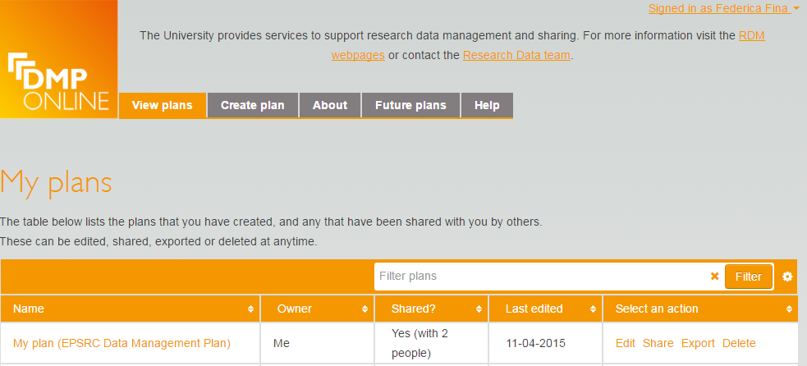
DMPonline
Plan
https://dmponline.dcc.ac.uk
Reuse
Create
Share
Process
Preserve

Slide 10
Create and process
Plan
File naming conventions
Directory structure
Version control
Document methods, procedures
Metadata
Reuse
Create
Share
Process
Preserve
Notes:
Mention - schools block storage

Slide 11
File naming
Make sure that the names of your files:
are consistent - within a research group, it's recommended that you agree on file naming conventions early on in the project
are concise but informative (clear logic) and meaningful to you and your colleagues
do not contain special characters (\ / : * ? “ < > | [ ] & $) or spaces
should not conflict when moved from one location to another
take account of how scalable your file naming convention needs to be; e.g. if you want to include the project/sample/subject number, don't limit the number to two digits, or you can only have ninety nine items.
Document the logic behind your file naming method
https://www.st-andrews.ac.uk/staff/research/data/organisation/

Slide 12
File naming in practice
Identification: project ID, researcher's initials, name of team, instrument…
Punctuation: decide on conventions for if and when to use punctuation symbols, capitals, hyphens. (“-” or “_” ?) Windows-not all characters are OK
Dates: agree on a logical use of dates so that they display chronologically i.e. YYYY-MM-DD.
Order: confirm which element should go first, so that files on the same theme are listed together and can therefore be found easily
Length: for windows the max file path length is 260 characters (https://msdn.microsoft.com/en-gb/library/windows/desktop/aa365247(v=vs.85).aspx#naming_conventions) – see files/folders organisation
Examples:
2015-10-02_XRD-P_ff23_SampleCode → 32 characters
2015-10-02_XRD-P-John_ff23_SampleCode → 37 characters

Slide 13
Bulk renaming
Keep in mind that tools exist (more or less sophisticated) that allow to bulk rename files.
Use cases:
for digital images that are automatically assigned filenames consisting of sequential numbers
for files created by proprietary software or instrumentation that are given default and meaningless filenames
for files transferred from a system that supports spaces and/or specific characters in filenames to one that doesn't (for example MAC to Windows). By using bulk renaming software such characters can be replaced by acceptable ones.
MAC: Name Changer; Renamer
Windows: Bulk Rename Utility

Slide 14
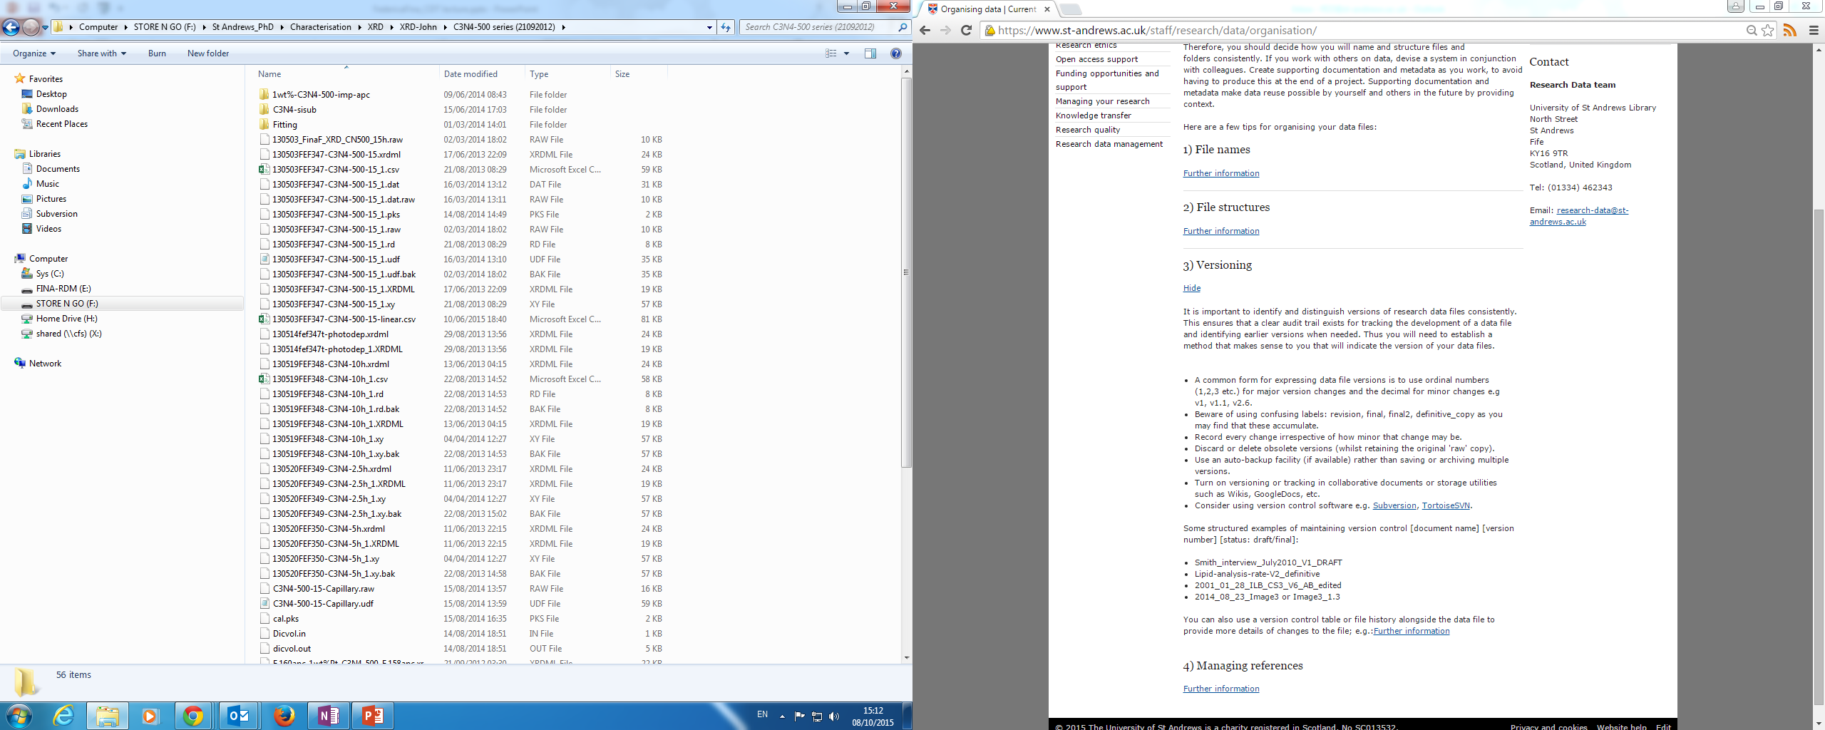
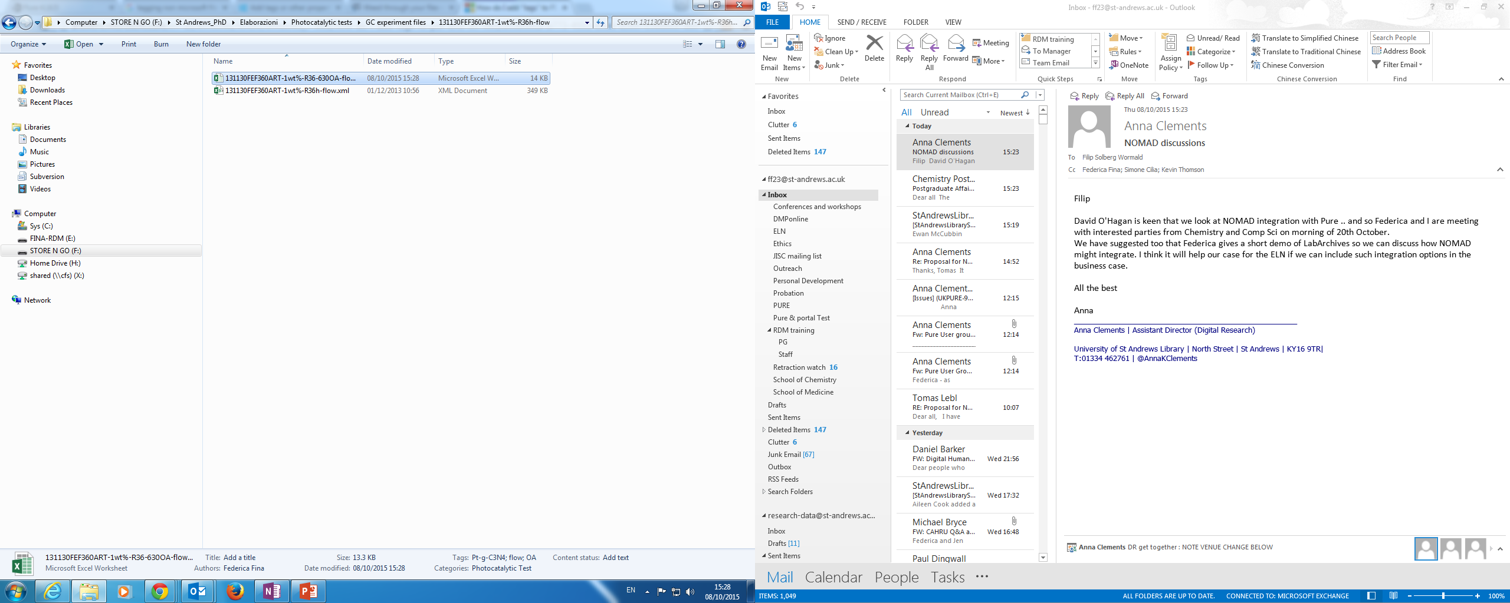
Directories structure
Keep in mind the 260 path length limit
Windows Explorer can sometimes be useful…use tags and categories

Slide 15
File versioning
Make sure to distinguish and identify different versions of your files
Keep track of versions by using numbers
v1, v2, v3… for major changes; v1-1, v1-2… for minor changes (no “.”)
Establish a clear and logic method, avoid confusing labels such as “revision, final, final2, definitive_copy etc.”
Always keep the “raw” copy (you can discard obsolete versions)
Use track changes features when using collaborative documents
Keep a version control table/notes describing each version
Examples:
2015_Platinum_Manuscript_v1 (you created this version-raw)
2015_Platinum_Manuscript_v1_ff23-edited (I edited v1)
2015_Platinum_Manuscript_v2 (you accepted the changes)
Software: TortoiseSVN

Slide 16
File formats
Proprietary and open
Proprietary/closed – can be opened with one or a very limited number of commercial software
Open – does not require a commercial software
Some formats can become obsolete with time
You may have access to expensive software now but not in the future
Try to save a copy in open formats
Example: xlxs to csv
https://en.wikipedia.org/wiki/List_of_open_formats
If you cannot use open format, describe the format you use and the software needed to open it

Slide 17
Documenting your data
Keep a data catalogue (file name, creator, location, instrument used etc.)
Take extensive notes
Write methodologies, procedures, SOPs
Describe variables and abbreviations
Describe file formats
Explain and describe any code you use (samples naming, files naming)
Keep track of versions history
Record all decisions you make about software and tools you use
Why did you decide to use a specific software?
What version did you use?

Slide 18
Documenting your data
Why should you document your data?
What seems clear and obvious to you today, may not be clear and obvious to you tomorrow
It will help you remember the details and the logic behind your research, decisions and actions
It will help others understand your research – (supervisor, collaborators, next researcher/PhD student, etc.)
It will help verify your findings and replicate your results
It will provide context to your archived data for access and re-use

Slide 19
Metadata
‘Data about the data’ – it increases discoverability and provide context
Structured xml files, machine readable
Some discipline have specific metadata schema
Generally three types: descriptive, technical and administrative metadata
Examples:
Title
Author
Abstract
Keywords
Rights (licence)
File format
File size
Relations (to other items such as instruments, datasets, publications…)
…
More info on metadata schemas at http://www.dcc.ac.uk/resources/standards

Slide 20
Store and Preserve
Plan
Active storage
Data currently in use
Archival storage
Data no longer in use but of medium to long term value
Back-up
Copy of active or archival storage
Reuse
Create
Share
Process
Preserve

Slide 21
University Central File Store (CFS)
HOME DRIVE
Postgraduates have 3GB of central file storage - http://www.st-andrews.ac.uk/media/it-services/documents/studentquickguide.pdf
How to map the Home Drive? http://www.st-andrews.ac.uk/filestorage/mappingtothenewcentralfilestorecfs/
PC: \\cfs.st-andrews.ac.uk\users\<username>
MAC: smb://cfs.st-andrews.ac.uk/users/<username>
GROUP STORAGE
SUPERVISOR STORAGE
Each Principal Investigator has 0.5TB free
Additional storage can be bought

Slide 22
Back-up: best practice
Do not keep all your eggs in one basket
the 3-2-1 rule:
at least three copies,
in two different formats,
with one of those copies off-site.
Have multiple copies on different devices. Ex.:
Work mainly on your laptop
Automatic back up on a group server AND
On your USB and/or external hard disk
Use back-up software:
SyncToy 2.1 : https://www.microsoft.com/en-gb/download/details.aspx?id=15155

Slide 23
Archival Storage
Not everything need to be archived/preserved - selection
Should be different from the active storage to minimise risk of loss, corruption, damage etc.
Digital Preservation:
Long-term storage
Back-up
Format migrations
Data repositories can be used (some are only for published data)

Slide 24




We are here to help!
Research Data Management team
01334 462343
research-data@st-andrews.ac.uk
http://researchdata.wp.st-andrews.ac.uk/
CC BY
https://www.flickr.com/photos/f-oxymoron/9647972522

Slide 25
Very generic Dublin Core Metadata schema (http://dublincore.org/metadata-basics/)
<?xml version="1.0"?>
<rdf:RDF xmlns:rdf="http://www.w3.org/1999/02/22-rdf-syntax-ns#"
xmlns:dc="http://purl.org/dc/elements/1.1/">
<rdf:Description>
<dc:creator>a</dc:creator>
<dc:contributor>b</dc:contributor>
<dc:publisher>c</dc:publisher>
<dc:subject>d</dc:subject>
<dc:description>e</dc:description>
<dc:identifier>f</dc:identifier>
<dc:relation>g</dc:relation>
<dc:source>h</dc:source>
<dc:rights>i</dc:rights>
<dc:format>j</dc:format>
<dc:type>k</dc:type>
<dc:title>l</dc:title>
<dc:date>m</dc:date>
<dc:coverage>n</dc:coverage>
<dc:language>o</dc:language>
</rdf:Description>
</rdf:RDF>

Slide 26
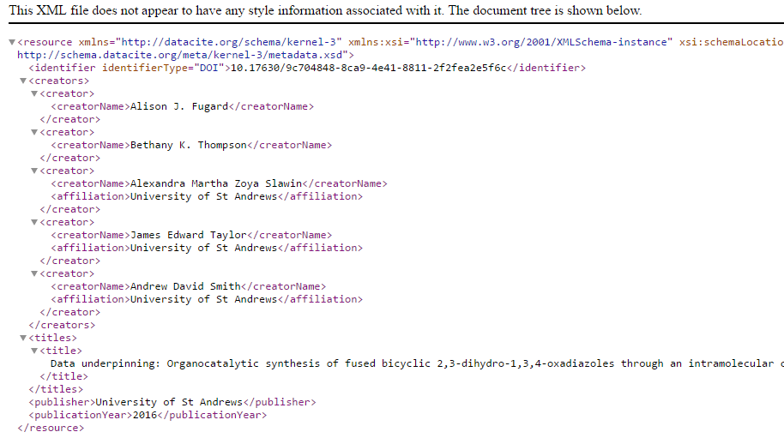
DataCite example: http://schema.datacite.org/meta/kernel-3/metadata.xsd

Slide 27
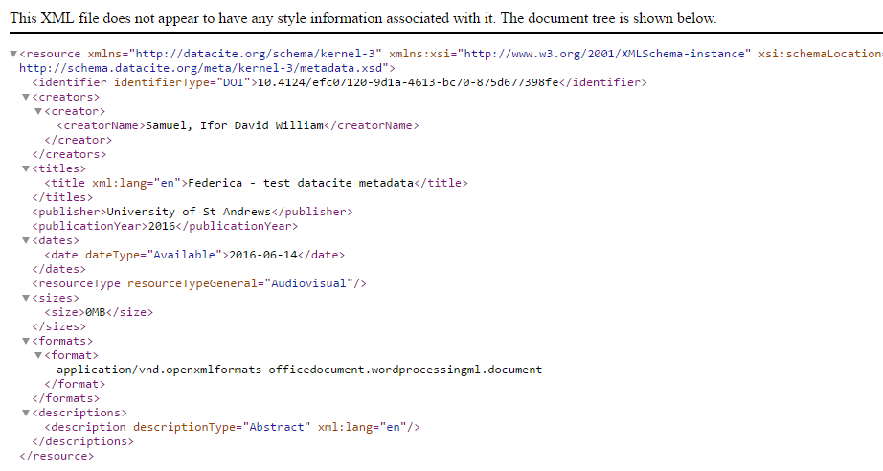
DataCite example: http://schema.datacite.org/meta/kernel-3/metadata.xsd
More info on metadata schemas at http://www.dcc.ac.uk/resources/standards

